Slide 1
胸懷世界，腳踏實地 以網路中心開拓潛在市場 Think Global. Act Local (Leveraging WebCenter to expand your potential markets
Chwen Lim
專業經理級經銷商 Professional Coordinator
四個佣金週期共賺取HK$34,500
HK$34,500 in 4 Commission weeks
本簡報中提到的收入等級純屬舉例說明，無意代表美安香港經銷商的一般收入，也無意表示任何經銷商皆可賺取同等收入。美安香港經銷商的成功與否，取決於其在發展事業時的努力、才能與投入程度。The income levels mentioned in the following presentation are for illustration purposes only. They are not intended to represent the income of a typical Market Hong Kong Distributor, nor are they intended to represent that any given Independent Distributor will earn income in that amount. The success of any Market Hong Kong Independent Distributor will depend upon the amount of hard work, talent, and dedication which he or she devotes to building his or her Market Hong Kong Business.

Slide 2
2013美安香港領袖訓練會議 Market Hong Kong 2013 Leadership School
胸懷世界，腳踏實地 以網路中心開拓潛在市場 Think Global. Act Local Leveraging WebCenter to expand your potential markets

Slide 3
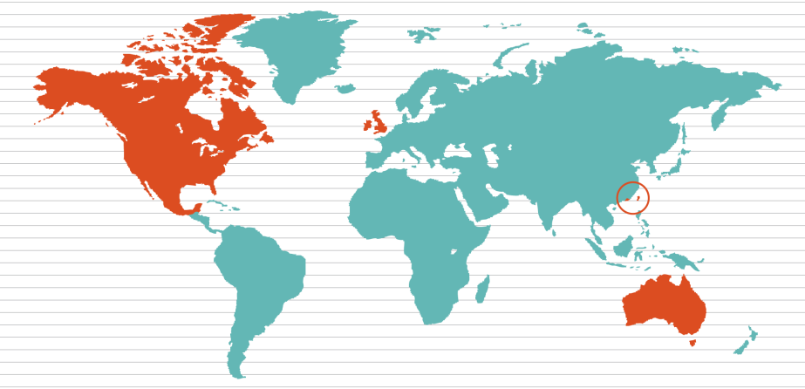
hk.shop.com
uk.shop.com
es.shop.com
shop.com
tw.shop.com
mx.shop.com
au.shop.com
global.shop.com
美安公司於全球營運，加拿大、墨西哥、澳洲、台灣、
香港及英國皆設有事業據點。新興市場包括西班牙、哥倫比亞、多明尼加共和國、厄瓜多爾及巴拿馬。
Market America operates globally in Canada, Mexico, Australia,
Taiwan, Hong Kong and the United Kingdom. EMP include Spain, Columbia, Dominican Republic, Ecuador and Panama.
Notes:
with shop.com expansion to global market

Slide 4
網上購物潮流 Online Shopping Trend: HK.SHOP.COM
有買
BUY
有賣
SELL
商家利用這平台推廣生意
A powerful channel for advertising
Notes:
On-line shopping becomes the trend where people buy and sell..
Shop.com becomes the “Channel” where businesses with e-commerce presence would want to leverage shop.com to drive traffic to their business.

Slide 5
用網路中心製作的網站 Websites built by WebCenter > HK.SHOP.COM
享用每日免費關鍵字更新
Enjoy FREE keywords submission daily
Notes:
for those without web presence, we can provide them with an effective, functional web solutions.

Slide 6
mhk WebCenter

Slide 7
你的全球網路中心 Your Global WebCenter
網路中心與新興市場計劃(EMP)
你的網路中心可在全球銷售網站，將網站銷售至所有市場國家/地區及新興市場計劃國家/地區！
WebCenters & EMP
Your WebCenter is automatically enabled to sell websites globally in all Market Countries & EMP Countries!
市場國家/地區 Market Countries | 新興市場計劃國家/地區 EMP
美國 USA 加拿大 Canada 墨西哥 Mexico 澳洲 Australia 台灣 Taiwan 香港 Hong Kong 英國 UK | 西班牙 Spain 哥斯達黎加 Costa Rica 多明尼加共和國 Dominican Republic 哥倫比亞 Columbia 厄瓜多爾 Ecuador 巴拿馬 Panama | 新加坡 Singapore 紐西蘭 New Zealand 菲律賓 Philippines 其他任何我們可以在語言和時間上提供支援的國家/地區！Any other country that we can support the language and support hours!
Notes:
7
leader-needs to have a bigger vision of global expansion
as webcenter is one of the first product to be introduced to all other countries…

Slide 8
美安香港網絡中心 = 簡單易用的解決方案 Webcenters is a Turn-key solution
為甚麼每間公司都需要網站？
Why every company needs a website?
Notes:
Importantly thing to know – “why" company needs website

Slide 9
每間公司都需要一個網站的原因 Why Every Company Needs a Website
網站是最經濟有效的廣告形式
7個工作日，每天24小時，沒有任何額外的開銷，你的銷售潛力將增加數倍
不需要親自到商店，就可以輕鬆地在網站上購買你的產品和服務
過去6年，全球網絡的銷售增長近400％，最好的捷徑是提升你的業務網絡
你的生意會顯得更加專業
The site is the most cost effective form of advertising.
7 business days, 24 hours a day, without any additional overhead, and your sales potential will be increased several times.
Does not require the customer to the store in person, you can easily purchase your products on the website and services
In the past six years, the global network of nearly 400% increase in sales, enhance your business network is the best shortcut
Your business will look more professional

Slide 10
要知道你和甚麼人合作 Know WHO you are partnering with
網路中心為我們提供了：
銷售/產品/網絡專家
技術支援 - 搜尋引擎優化、 網站編輯、電子郵件專家、社交媒體專家等
設計中心
Webcenter provides us with the following support:
Sales / Product / Web Specialist
Technical Support – SEO, Web editing, email specialist, Social Media specialist, etc
Design Center

Slide 11
我們有專業團隊 Our Team of Professionals
產品專家
為你作示範， 銷售網站！
Product Specialist does the appointment / Sells the Website for YOU !
你
約三線通時間 YOU Set the Appointment
顧客服務
為你的顧客處理所有技術支援！
Customer Care handles all Technical Support for your customer!
你
賺取零售利潤、225 BV 及每月25 BV、活躍顧客 YOU
Earn Retail Profit, 225 BV & 25 BV / Month, active customer

Slide 12
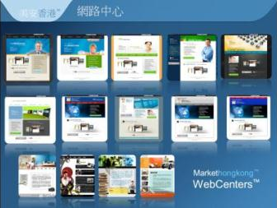
技術人員 vs. 簡易方案 Technician vs. Turn-key solution
自己建立
Build by yourself
購買現成產品
Buy ready made

Slide 13
Notes:
13
Here are some examples of sites done with our design center.
You can see how professional these designs look.
Any business owner would be proud to have one of these websites for their own.
We are constantly sharing the latest work by our design center on our Facebook Page: facebook.com/officialmawebcenters

Slide 14
度身訂造/響應式設計+流動網站 Fully customized/responsive design with mobile site

Slide 15
經銷商個人網站：產品中的產品 Distributor’s personal website: the product of the product
成為一個領袖，帶領你的團隊借力網路中心 Be a leader, lead your team to leverage WebCenter
Notes:
This is a leadership school.
we are leader to our client
We are leader to our organisation
If we can lead by starting to use the DRS, the effect will be incredible

Slide 16
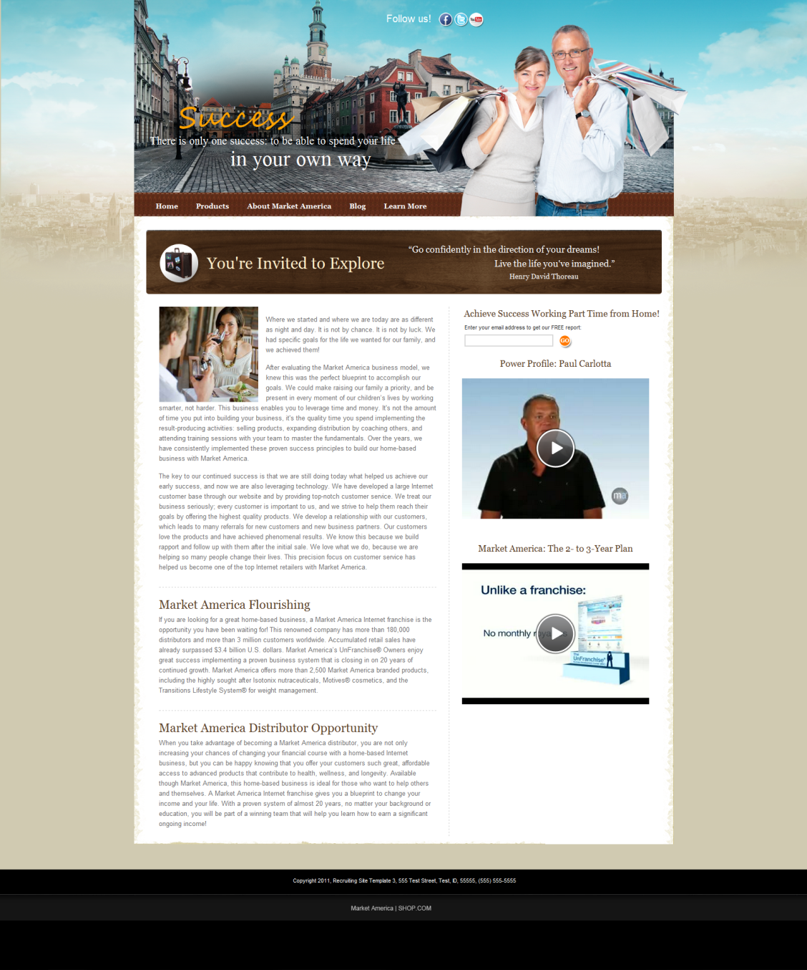
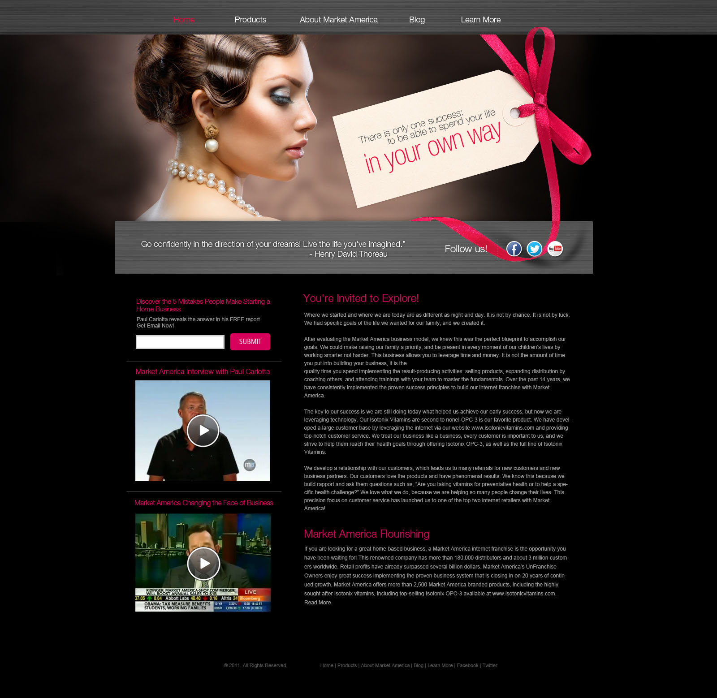
我們的經銷商也有個人網站
Our distributor’s personal website
Notes:
Examples of DRS, new templates are available
For customised design, can hire design center to do it like what our client does.

Slide 17
經銷商個人網站：產品中的產品
Use your Personal website (DRS)
as Product of the Product
物色、招募、跟進 Prospecting, Recruiting, Sponsoring
變得簡單！
Gets easier!
你 About You
連接Shop.com
Connect SHOP.COM
你最喜歡的資源 Your Favorite Resources
兩分鐘廣告 Your 2 mins
你的故事
Your story
你的主修
Your Major

Slide 18
用的是網路中心的先進科技 Using cutting edge tools with WebCenter technology

Slide 19
成功的行動計劃：腳踏實地起步！ Your Action Plan for Success: Act Local!
2013美安香港領袖訓練會議
特別優惠 Market Hong Kong 2013 Leadership School SPECIAL
購買3張2014美安香港年會門票，即可免費獲贈美安香港網路中心*
During 2013 Hong Kong Leadership School, purchase a minimum of three 2014 Hong Kong Annual Convention tickets in a single order and you’ll receive:
Your own Market Hong Kong WebCenter™*
For FREE!
* 網路中心月費為港幣275元
WebCenter monthly service fee is $275/month
Notes:
take advantage of the events specials

Slide 20
成功的行動計劃：腳踏實地起步！ Your Action Plan for Success: Act Local!
2013美安香港領袖訓練會議
特別優惠 Market Hong Kong 2013 Leadership School SPECIAL
只限本週末
到網路中心攤位，立即起步！
This weekend only.
Come to the WebCenter Booth and get started today!
HK$2,730 & 300 BV
* 網路中心月費為港幣275元
WebCenter monthly service fee is $275/month
Notes:
take advantage of the events specials

Slide 21
網路中心快速入門套裝 The all new WebCenter Fast Start Kit
網絡中心（HK6040） WebCenter (HK6040)
經銷商認購套装 Distributor Subscription Kit
起步指南手冊 Getting Started Guide
Powerline月刊（超連鎖創業專刊）
會議聯盟系統的支援，獲得經驗豐富的超連鎖店主培訓與指導 NMTSS support system
專業手冊 Hong Kong maCatalog
全球年度報告 Global Annual Report
圖冊 Small Flip Charts
香港“系統”DVD HK “The System” DVD
超連鎖™事業帳戶 2 months UFMS
讓新的經銷商最簡單開始的配套！
The easiest way to get a new distributor started in the WebCenter program
Notes:
Webcenter fast start kit available

Slide 22
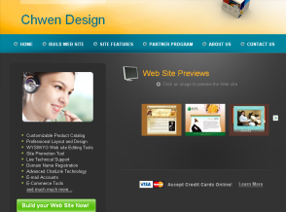
網路中心的支援 Support provided by WebCenters
Notes:
Webcenters program is an unique platform in MA university- where full range of supports are provided

Slide 23
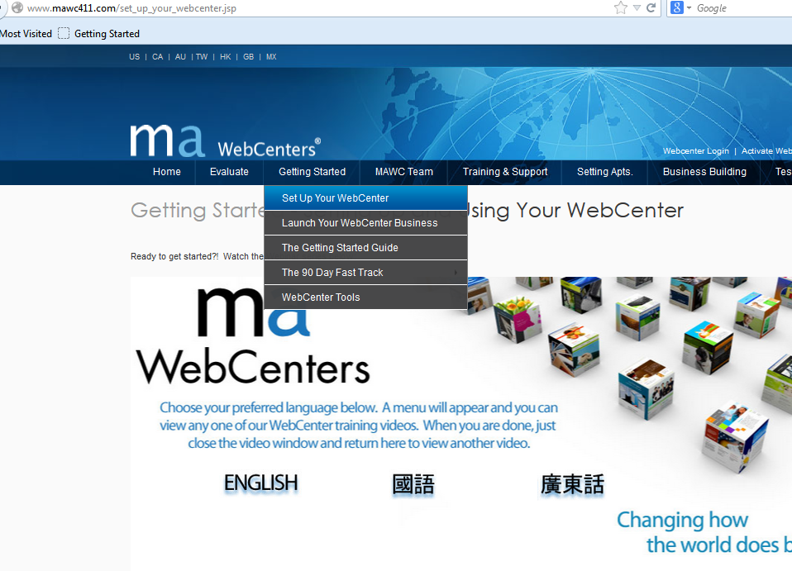
WebCenter product code: 6040
Go to MAWebCenters.com
Enter your RepID where it says - “Activate WebCenter”
Then follow the instructions
The “Getting Started Guide” on www.mawc411.com goes through all of this in detail
Notes:
The mawc411 site has a link with helpful video tutorials on how to set up your new WebCenter

Slide 24
網路中心授證訓練101 WebCenter Certification training 101
「網路中心成功之道」
“Succeeding with WebCenters”
Notes:
Take advantage of wct101

Slide 25
WebCenter Certification training 201
「透過社交網路邁向成功之道」 藉由美安網路中心進行進階銷售與建立社交網路
“Networking your way to success” Advanced Selling & Networking with maWebCenters
網路中心授證訓練(WCT) 201
WebCenter Certification Training 201
Notes:
Take advantage of wct201

Slide 26
你的全球網路中心 Your Global WebCenter
網路中心與新興市場計劃(EMP)
你的網路中心可在全球銷售網站，將網站銷售至所有市場國家/地區及新興市場計劃國家/地區！
WebCenters & EMP
Your WebCenter is automatically enabled to sell websites globally in all Market Countries & EMP Countries!
市場國家/地區 Market Countries | 新興市場計劃國家/地區 EMP
美國 USA 加拿大 Canada 墨西哥 Mexico 澳洲 Australia 台灣 Taiwan 香港 Hong Kong 英國 UK | 西班牙 Spain 哥斯達黎加 Costa Rica 多明尼加共和國 Dominican Republic 哥倫比亞 Columbia 厄瓜多爾 Ecuador 巴拿馬 Panama | 新加坡 Singapore 紐西蘭 New Zealand 菲律賓 Philippines 其他任何我們可以在語言和時間上提供支援的國家/地區！Any other country that we can support the language and support hours!
Notes:
26
leader-needs to have a bigger vision of global expansion
as webcenter is one of the first product to be introduced to all other countries…

Slide 27
.
Notes:
27

